Slide 1




Stock market trading signals using AI…
Trade YoUR Brains Out!
Mikateko Ursula Ngobeni
Miroslav Chomut
Vladimir Rybalko
Ondrej Bilka
Jakub Lerl
Olivie Franklova
Ales Hrabe
Brendan Bignell
CIB – IB #17
How can we develop a stock market trading indicator based on the Artificial Intelligence pattern recognition algorithmic approach to boost the performance of existing strategies and complement them in their decision-making?
Notes:
TODO – Add pictures for all team members ☺

Slide 2







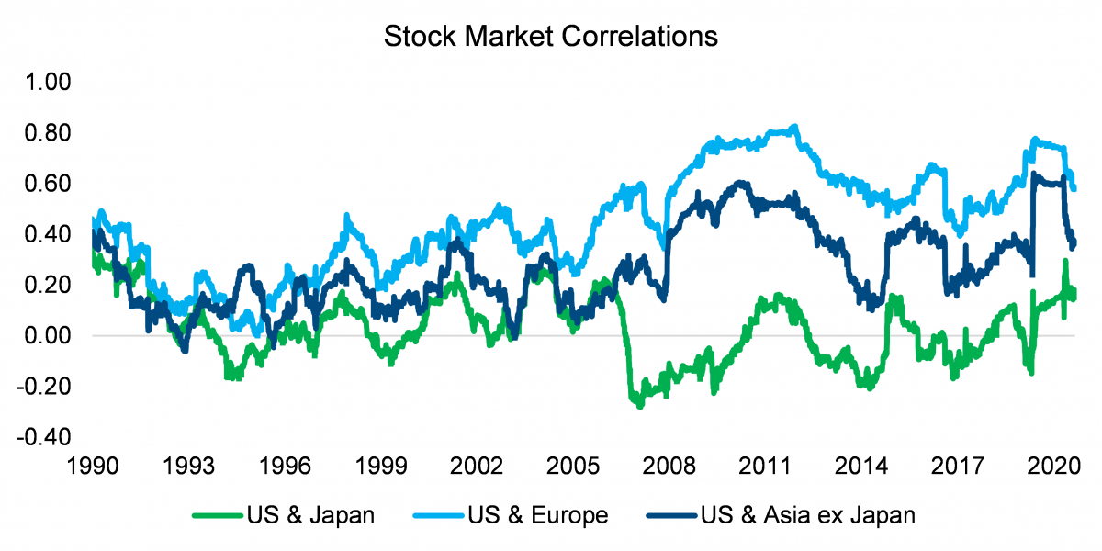

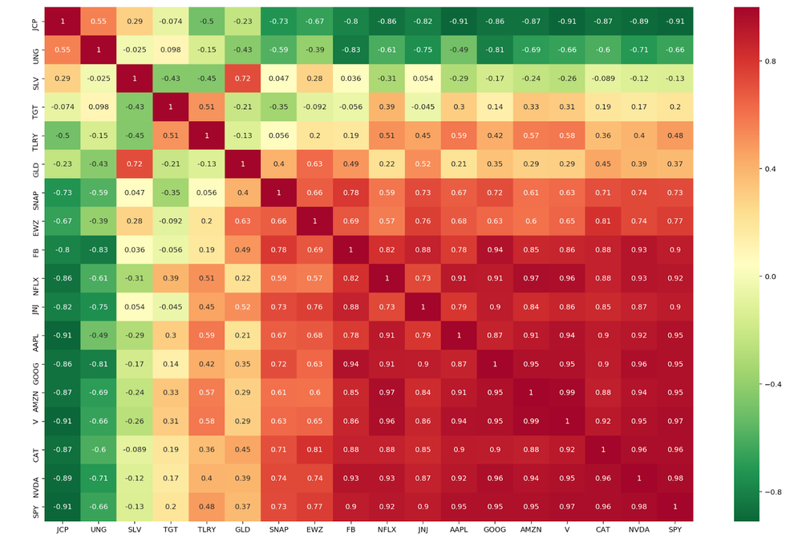
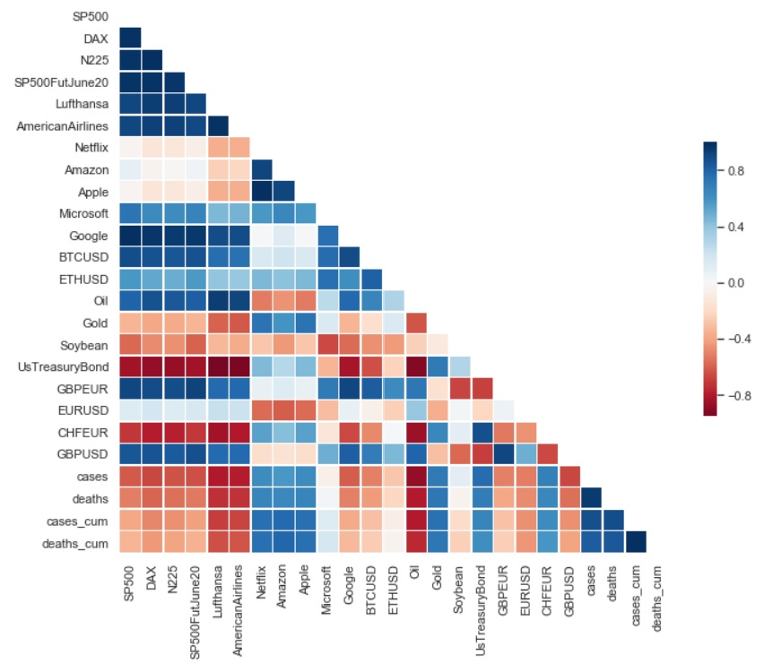


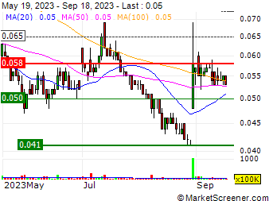
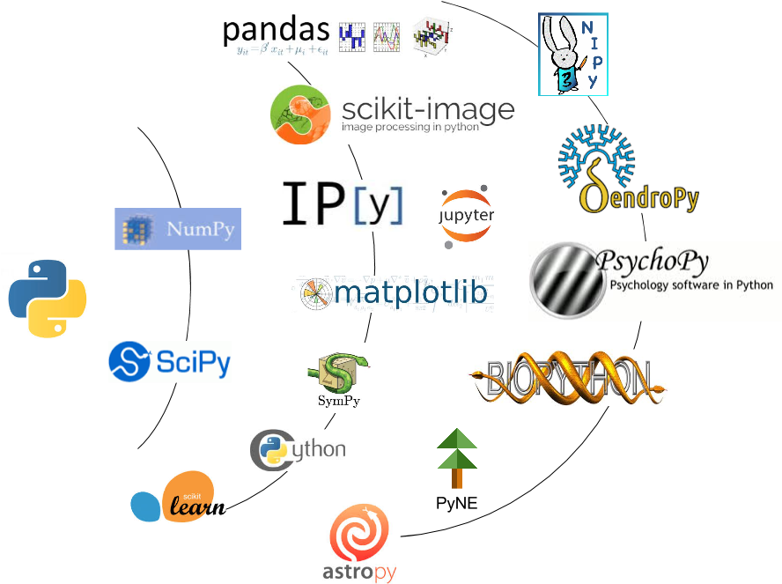
Concept
Create a hypothesis for a viable stock trading strategy.
Find suitable historic market data providers and assemble required historical market data and financial news.
Perform a statistical analysis of the market data and generate potentially useful features for training ML models.
Leverage large language models (LLMs) and/or NLP models to perform sentiment analysis of financial news.
Choose, evaluate and train suitable ML prediction models to learn the patterns in a subset up of the historical data.
Measure the quality of predictions vs benchmarks using data the models have not seen.
Iteratively make improvements to the strategy, data analysis, models and hyperparameters then measure performance.
Make stock predictions for the current day on the JSE!
Show how the ML models can be analyzed to show which trading indicators are considered significant.
FinBERT
TA-Lib
Notes:
Hello. We are team Turbo and we are taking on the CIB #17 problem.
We have a rather ambitious goal to build a complete end-to-end solution that will test the ‘efficient market hypothesis’ by evaluating if the JSE has information from foreign stock markets priced into it when it opens each day.
To do this we will source diverse financial data from multiple stock markets, and also commodity, FX and bond prices. In addition, we will use a Large Language ML Model to analyze financial news related to the stocks for sentiment.
We will then show how trading signals can be generated from this and using advanced Machine Learning techniques build a stock prediction models that will predict the daily change in each of the Top 40 JSE stocks. We will also implement methods to quantitatively evaluate the performance of the models. If we have enough time we will also build a simulated trading bot which uses the models to make trades on the JSE and evaluate the performance.
For the hackathon on a diverse team spanning SA and Prague with members form many ABSA project areas was assembled. We are represented by 5 nationalities and range in ages from 22 to 52. We hope you will enjoy evaluating our entry!

Slide 3









Trading signals hypothesis
The Johannesburg Stock Exchange (JSE) opens as the markets of Asia and Oceania close.
Macroeconomic factors will have been priced into the markets ahead of the JSE with more current information likely to be in the markets closest in time to the JSE. It is hypothesized that for each JSE stock we can find a basket of stocks and ETFs from prior overseas markets that will have somewhat correlated price movements with the target JSE stock.
For each JSE stock we will build custom ML models which use historical and recent price/volume data for the target JSE stock, the basket of related foreign stocks/ETFs plus other market data such as FX rates, commodity and bond price movements to build a set of trading indicators which may help predict the next day price for the JSE stock. ML models will then be trained to combine indicators with the goal of correctly predicting price movements.
Recent news related to the target stocks and markets with be gathered from multiple sources. News will be evaluated for sentiment and used in downstream price prediction models.
Global Markets
Warm
Hot
NYSE
ASX
Correlated trade price action
JSE
SSX
sentiment
We will use statistics to look for asset correlations that are stable over time and that don’t have unwanted reversals.
JSX
Cold
Trading hours
Reality Check! A hacked together strategy/model stack using poor quality market data is unlikely to profitable, but we will back-test and measure performance to demonstrate the end-to-end process of building a sophisticated AI/ML based signal generation pipeline using open-source tools.
By using a weighted basket of correlated assets to make predictions we should be less sensitive to data quality issues in the historic data as each constituent contributes only a fraction and hence data quality issues should have less impact.
Notes:
Market are classified as hot if the market closes just before the JSE opens. Markets are classes as cold if another dominant market closes later and hence should have better knowledge of macroeconomic factors priced in. As the worlds biggest stock market, the NYSE is classed as warm, but not hot due to Asian markets trading later.

Slide 4
Process flow – From data to decisions
Data Acquisition
Find free market data sources
Data Quality
Deal with missing, invalid and strange values in structured data
Feature Engineering
Calculate correlations across the markets and build synthetic proxy stocks for each JSE stock from a baskets of foreign assets
No X/Twitter feeds (too costly)
Filter and clean unstructured data removing markup
Convert absolute price movements to relative % change
Generate a wide range of potentially useful indicators from the historic data for the target and proxy stocks
Source historical stocks data and financial news.
Work around rate limiting
Use multiple sources
Normalize data
ML Modelling
Train prediction models on features engineered from the historic data and the output of the sentiment models
Use sentiment analysis models to classify financial news
Predict Future
Predict JSE stock movements for today using the trained ML models
Insights and Apps
Generate a breakdown of how each model arrived at the prediction
Build a stock prediction analysis dashboard which would be intuitive to use to make trading decisions
Test the ML models and evaluate performance on unseen portions of the data
Show predictions on charts along with signals
Provide a confidence estimate with each prediction.
Notes:
The process flow is rather serial in nature and if we fail to obtain historic market data not much of value can be done with the rest of the pipeline, but we will try to parallelize development for the steps as much as possible given the limit time available in the hackathon.

Slide 5
Planned system architecture/tech stack

Slide 6
What did we achieve during the Hackathon?
We sourced freely available daily historic stock data for 4y for the top 100 stocks on JSE, ASX, SSX, JPX and NYSE. Also, historic FX Rates and assets related to government bonds, commodities. The majority of the data was to be used for ML model training and a portion for later model performance evaluation.
We build a framework for evaluating model performance, calculating RMSE, R^2 and interactive visualization charts.
We cleaned and normalize the data and moved the close prices one day forward as a target values.
We build a several basic ML prediction models using such as Random Forest and XGBoost on the basic historic data to evaluate performance.
For each JSE stock we calculated for each foreign market 10 stocks showing the highest degree of Pearson correlation in price daily movements.
We added 50+ technical indicators to each JSE stock derived from the price/volume history day.

Slide 7

Summary
TODO
Write a summary of what was achieved during the hackathon and document where to find code etc.

